Slide 1
Ensemble Methods
DSBA/MBAD 6211

Slide 2
Ensemble Methods
Also called classifier combination methods
Techniques for improving classification accuracy by aggregating the predictions of multiple classifiers
Constructs a set of base classifiers from training data and performs classification by taking a vote on the predictions made by each base classifier

Slide 3
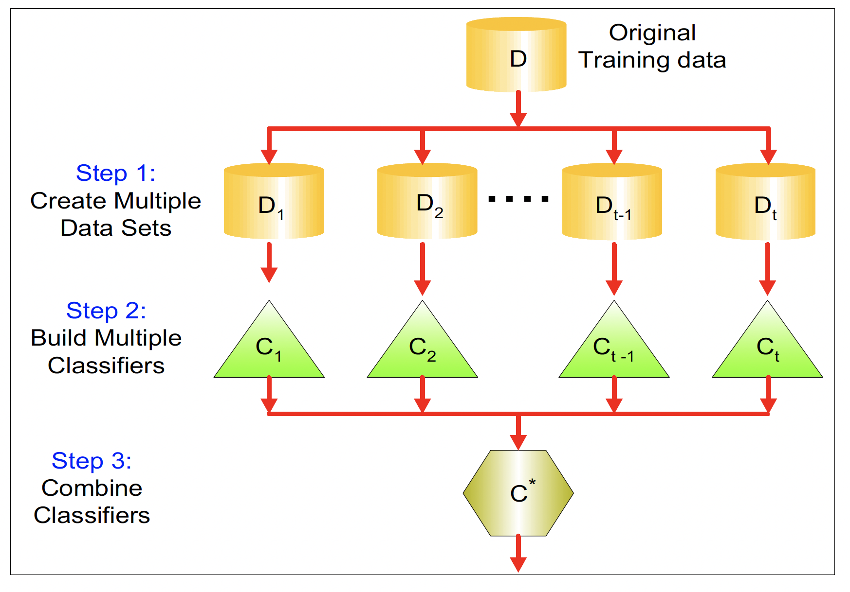
General Idea

Slide 4

How does it work?
Assume we have 25 base classifiers:
Each classifier has error rate, $ε=0.35$
Assume classifiers are independent
Probability that the ensemble classifier makes a wrong prediction is:
?

Slide 5
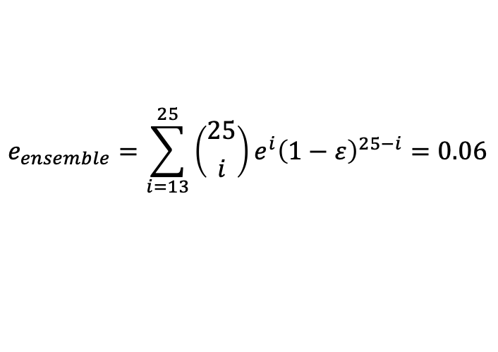
How does it work?
Assume we have 25 base classifiers:
Each classifier has error rate, $ε=0.35$
Assume classifiers are independent
Probability that the ensemble classifier makes a wrong prediction is:
$$e_{ensemble}=\sum_{i=13}^{25}{\left({25 \atop i}\right)e^{i}{\left(1−ε\right)}^{25−i}=0.06}$$

Slide 6
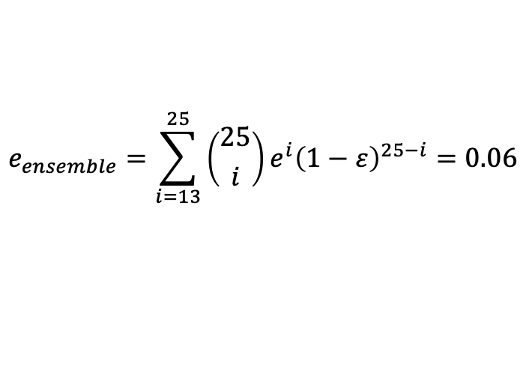

How does it work?
Assume we have 25 base classifiers:
Each classifier has error rate, $ε=0.35$
Assume classifiers are independent
Probability that the ensemble classifier makes a wrong prediction is:
$$e_{ensemble}=\sum_{i=13}^{25}{\left({25 \atop i}\right)e^{i}{\left(1−ε\right)}^{25−i}=0.06}$$
There are two necessary conditions for an ensemble classifier to perform better than a single classifier:
The base classifier should be independent of each other.
The base classifier should do better than a classifier that performs random guessing.

Slide 7
Ensemble Classifier Construction
By manipulating the training set
By manipulating the training features
By manipulating the class labels
By manipulating the leaning algorithm
1,2 and 3 are generic methods applicable to any classifier, 4 depends on the type of the classifier used.

Slide 8
Manipulating the training set
Multiple training sets are created by resampling the original data according to some sampling distribution.
A classifier is then built from each training set using a particular learning algorithm examples include (bagging and boosting).

Slide 9
Manipulating the training features
A subset of input features is chosen to form each training set.
The subset can be either chosen randomly or based on recommendation of domain experts.
Example include Random Forest.

Slide 10
Manipulating the class labels
Used when the number of classes is sufficiently large.
The training data is transformed into a binary class problem by randomly partitioning the class labels into two disjoint subsets, A₀ and A₁.
Some classes are assigned to subset A₀ and belong to class 0 and the remaining classes are assigned to set A₁ and belong to class 1.
The labeled examples are then used to train a base classifier. By repeating the class-relabeling and model-building steps multiple times, an ensemble of base classifiers is obtained.
Example includes error correcting code

Slide 11
Manipulating the leaning algorithm
Many learning algorithms can be manipulated in such a way that applying the algorithm several times on the same training data may result in different models.
For example, an artificial neural network can produce different models by changing its network topology or the initial weights of the links between neurons.
Similarly, an ensemble of decision trees can be constructed by injecting randomness into the tree-growing procedure. For example, instead of choosing the best splitting attribute at each node, we can randomly choose one of the top k attributes for splitting

Slide 12
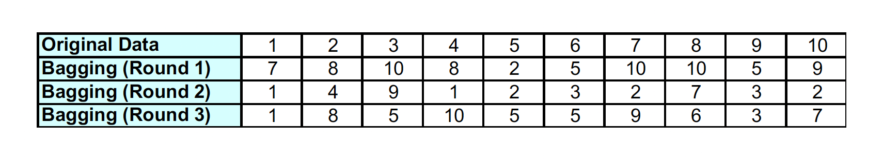

Bagging
Bagging, also known as bootstrap aggregating, is a technique that repeatedly samples (with replacement) from a data set according to a uniform probability distribution. Each bootstrap sample has the same size as the original data. Because the sampling is done with replacement, some instances may appear several times in the same training set, while others may be omitted from the training set. On average, a bootstrap sample D_{i} contains approximately 63% of the original training data.
Each sample has a probability
in each D_{i}
$$1−{\left(1−1/N\right)}^{N}$$

Slide 13

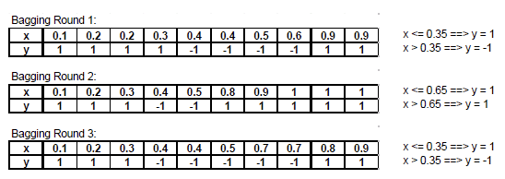
Bagging
Data (x)
Label (y)
sample
Weak classifier: 1-level binary decision tree - decision stump

Slide 14
Bagging
Data (x)
Label (y)
sample

Slide 15
Bagging
Data (x)
Label (y)
sample

Slide 16
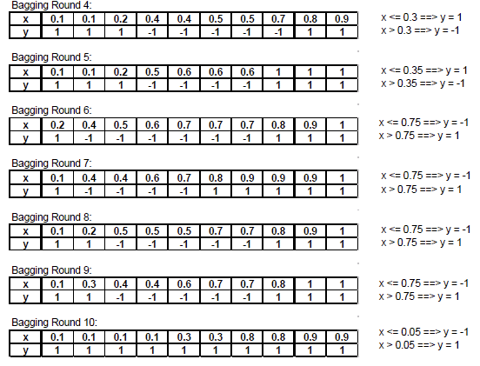
Bagging

Slide 17
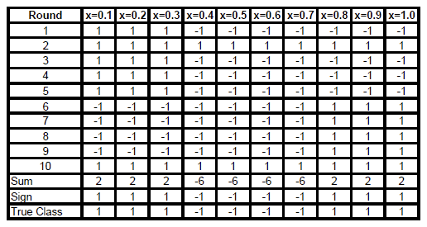
Bagging

Slide 18
A Random Forest
An ensemble model is an aggregation of more than one model where the final prediction of the model is a combination of the predictions from the component models of the ensemble.
A random forest model is an ensemble of classification or regression trees.
The forest models were developed to overcome the instability that a single classification or regression tree exhibits with minor perturbations of the training data.
Visualization: https://towardsdatascience.com/why-random-forests-outperform-decision-trees-1b0f175a0b5

Slide 19
Instability
One reversal
Accuracy = 81%
Accuracy = 80%

Slide 20
Perturb
T₁
T₂
T₃

Slide 21
Combine
T₁
T₂
T₃
ave(T₁, T₂, T₃) =

Slide 22
Random Forest
Why is it called random in ‘Random Forest’?
“Random” refers to mainly two processes:
random observations to grow each tree and
random variables selected for splitting at each node (e.g., sqrt of number of variables).
Notes:
How do we make each tree different
Trees in the forest differ from each other in two ways:
Training data for a tree is a sample from all observations.
Input variables considered for splitting a node are randomly selected from available inputs. Only the variable most associated with the target is split for that node.
Trees in the forest differ from each other in two ways:
Classification tree Mtry = sqrt of the number of independent variables
Regression tree mty = number of independent variables/3
Combining predictions from multiple models in ensembles works better if the predictions from the sub-models are uncorrelated or at best weakly correlated.
Random forest changes the algorithm for the way that the sub-trees are learned so that the resulting predictions from all of the subtrees have less correlation.
Random sampling of training observations
When training, each tree in a random forest learns from a random sample of the data points. The samples are drawn with replacement, known as bootstrapping, which means that some samples will be used multiple times in a single tree. The idea is that by training each tree on different samples, although each tree might have high variance with respect to a particular set of the training data, overall, the entire forest will have lower variance but not at the cost of increasing the bias.
At test time, predictions are made by averaging the predictions of each decision tree. This procedure of training each individual learner on different bootstrapped subsets of the data and then averaging the predictions is known as bagging, short for bootstrap aggregating.
Random Subsets of features for splitting nodes
The other main concept in the random forest is that only a subset of all the features are considered for splitting each node in each decision tree. Generally this is set to sqrt(n_features) for classification meaning that if there are 16 features, at each node in each tree, only 4 random features will be considered for splitting the node. (The random forest can also be trained considering all the features at every node as is common in regression. These options can be controlled in the Scikit-Learn Random Forest implementation).
Summary
The random forest combines hundreds or thousands of decision trees, trains each one on a slightly different set of the observations, splitting nodes in each tree considering a limited number of the features. The final predictions of the random forest are made by averaging the predictions of each individual tree.
The random forest is a classification algorithm consisting of many decisions trees. It uses bagging and feature randomness when building each individual tree to try to create an uncorrelated forest of trees whose prediction by committee is more accurate than that of any individual tree.

Slide 23
How Random Forest Works
Random record selection
Random variable selection (say, m)
Classification model: m is the square root of the total number of predictors
Regression model: m is one third of the total number of predictors
For each tree, calculate the error rate
Aggregate error from all trees to determine the RF performance
Determine the results by averaging votes over all trees in the forest

Slide 24
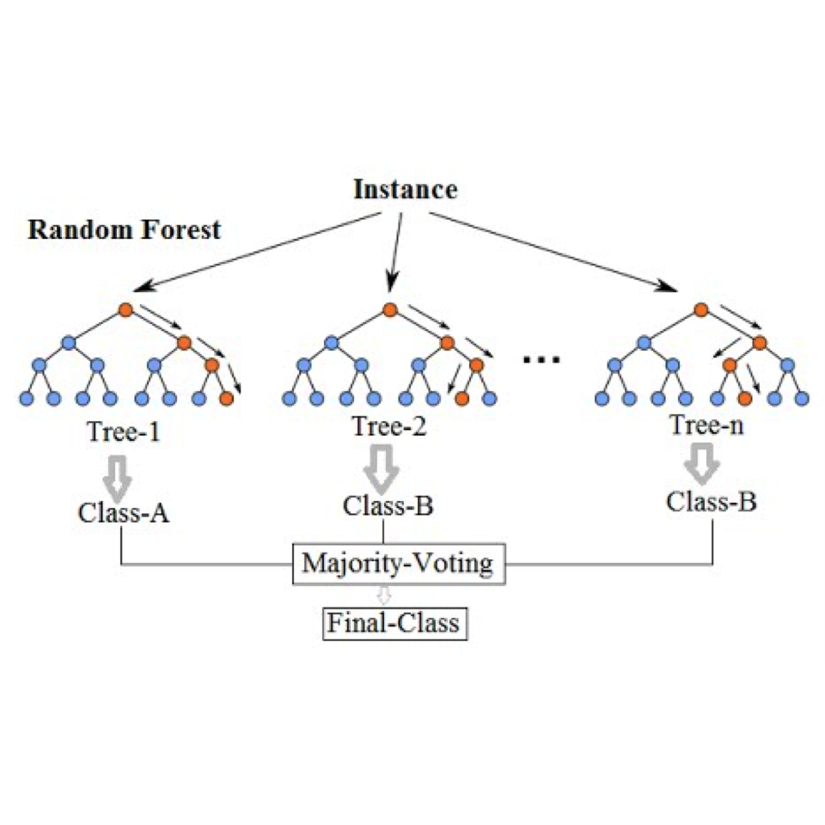
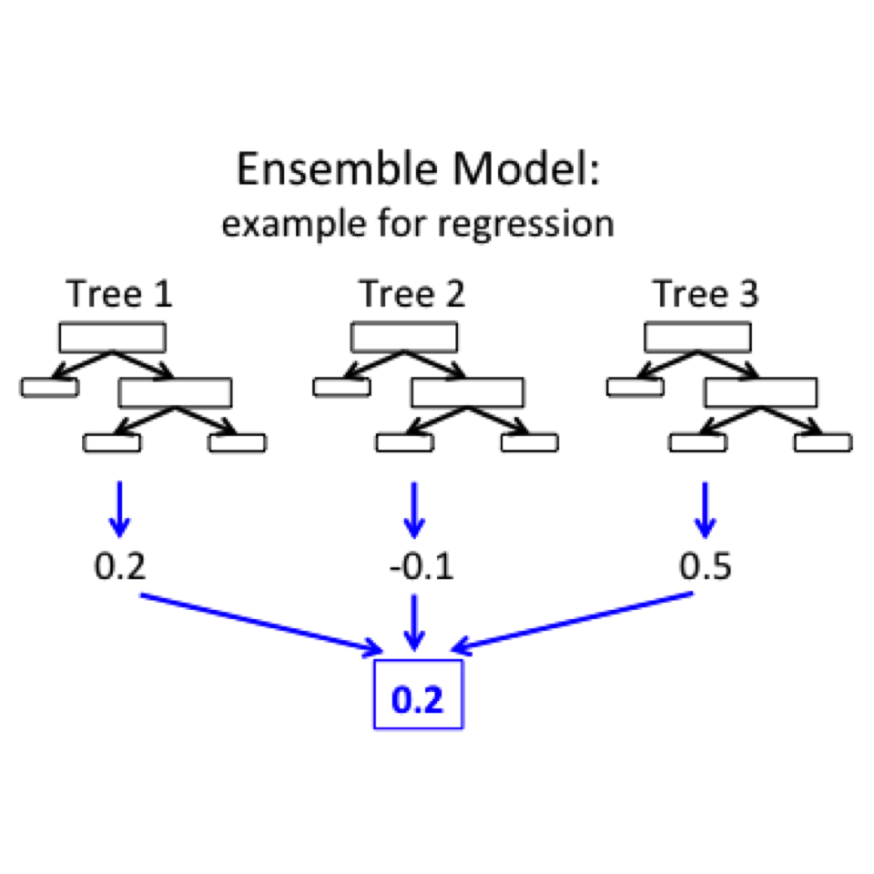

Slide 25
Boosting
Boosting is an iterative procedure used to adaptively change the distribution of training examples so that the base classifiers will focus on examples that are hard to classify. Unlike bagging, boosting assigns a weight to each training example and may adaptively change the weight at the end of each boosting round. The weights assigned to the training examples can be used in the following ways:
1. They can be used as a sampling distribution to draw a set of bootstrap samples from the original data.
2. They can be used by the base classifier to learn a model that is biased toward higher-weight examples.

Slide 26
Boosting
Boosting converts the “weak” learning algorithm into the strong one
Initially all N records are assigned the same weight 1/N
Unlike in bagging, in boosting the weights may change at the end of the run
An iterative technique to adaptively change distribution of training data by focusing more on previously misclassified records
Records that are wrongly classified will have their weights increased
Records that are classified correctly will have their weights decreased

Slide 27
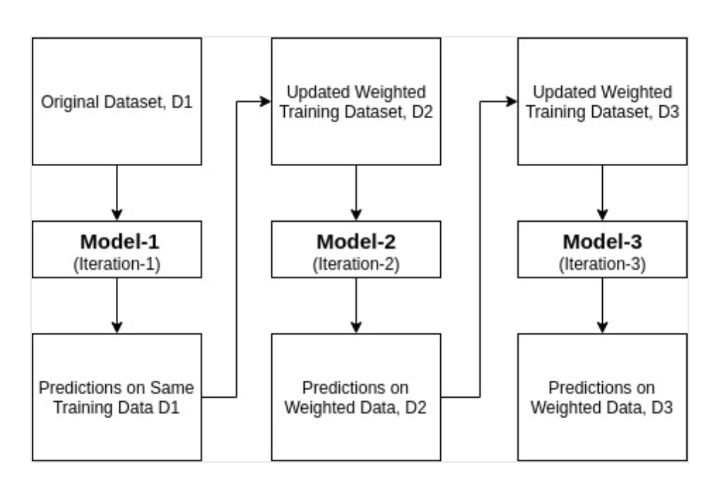
Boosting

Slide 28
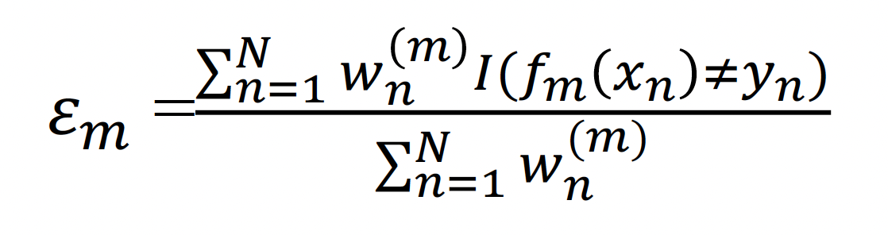
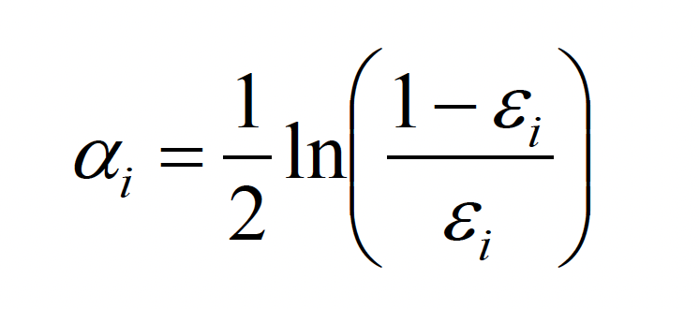
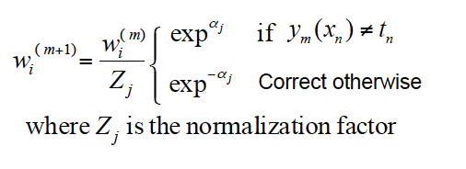
AdaBoost
Evaluate:
And then:
Weights:

Slide 29
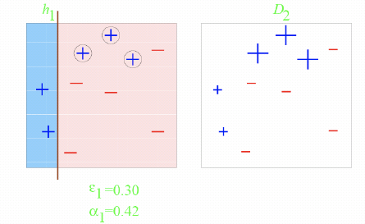
AdaBoost Example

Slide 30
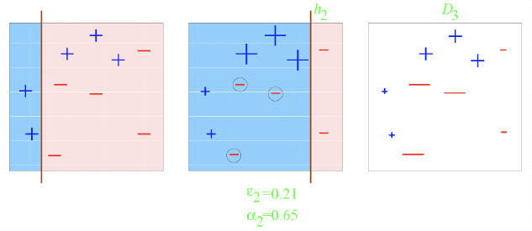
AdaBoost Example

Slide 31
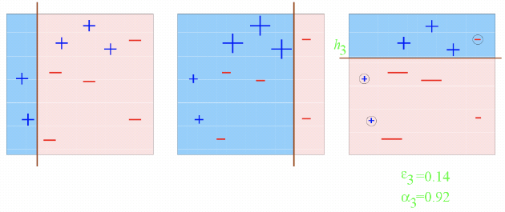
AdaBoost Example

Slide 32
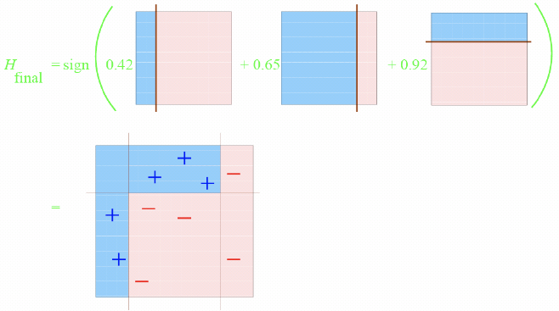
AdaBoost Example

Slide 33
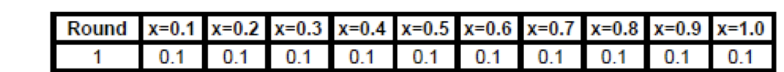
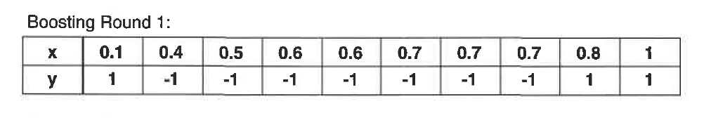
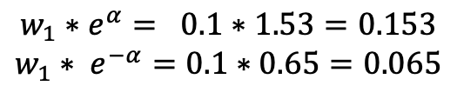
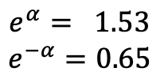

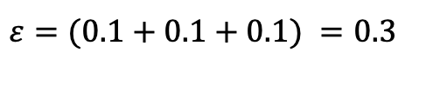
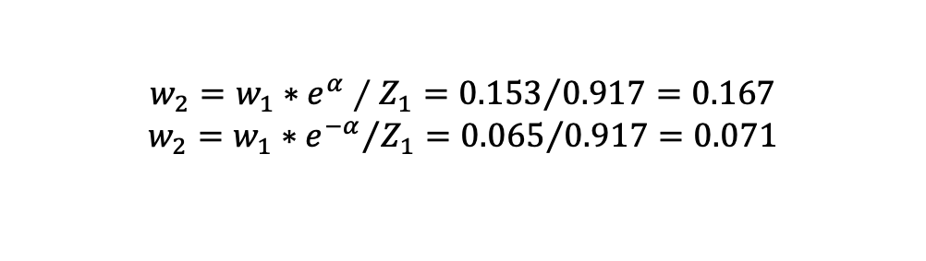
AdaBoost Example 2
Data (x)
Label (y)
Training weights
X <= 0.75 -1
X > 0.75 1
$$ε=(0.1+0.1+0.1) =0.3$$
$$e^{α}= 1.53$$
$$e^{−α}=0.65$$
normalization
$$Z_{1}=3∗0.153+7∗0.065=0.917$$
$$α=0.4236$$
incorrect
$${w_{1}∗e}^{α}= 0.1∗1.53=0.153$$
$$w_{1}∗ e^{−α}=0.1∗0.65=0.065$$
$${{w_{2}=w}_{1}∗e}^{α}∕Z_{1}={0.153}/{0.917=0.167}$$
$${w_{2}=w}_{1}∗{e^{−α}}/{Z_{1}}={0.065}/{0.917}=0.071$$
correct

Slide 34
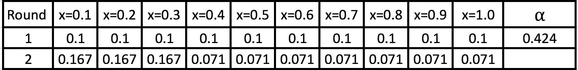
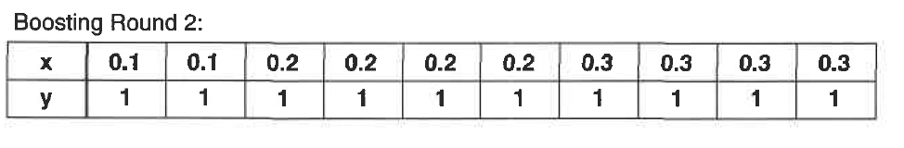
AdaBoost Example 2
Data (x)
Label (y)
weights
X <= 0.05 1
sample
X > 0.05 1

Slide 35
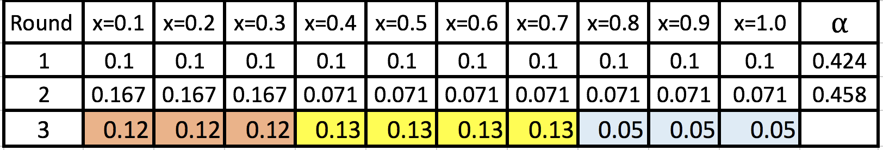
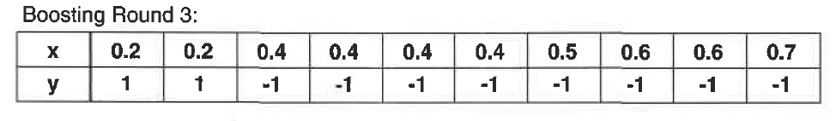
AdaBoost Example 2
Data (x)
Label (y)
weights
X <= 0.3 1
sample
X > 0.3 -1

Slide 36
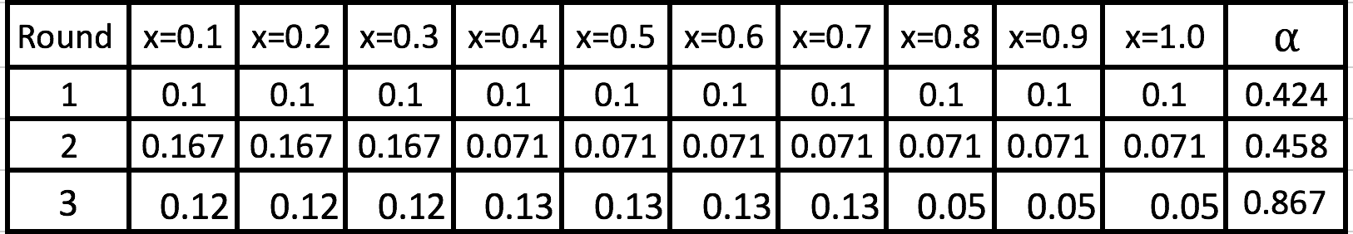
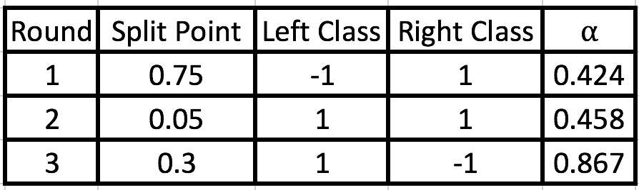
AdaBoost Example 2
weights
split

Slide 37
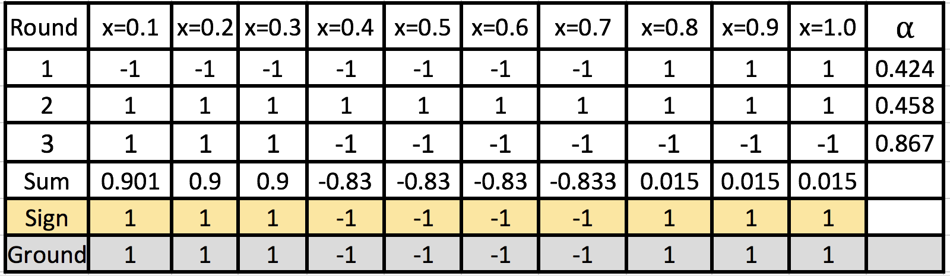
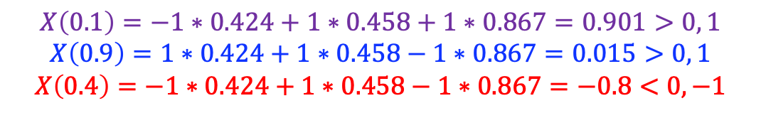
AdaBoost Example 2
$$X\left(0.1\right)=−1∗0.424+1∗0.458+1∗0.867=0.901>0, 1$$
$$X\left(0.9\right)=1∗0.424+1∗0.458−1∗0.867=0.015>0, 1$$
$$X\left(0.4\right)=−1∗0.424+1∗0.458−1∗0.867=−0.8<0, −1$$

Slide 38
AdaBoost Example 2

Slide 39
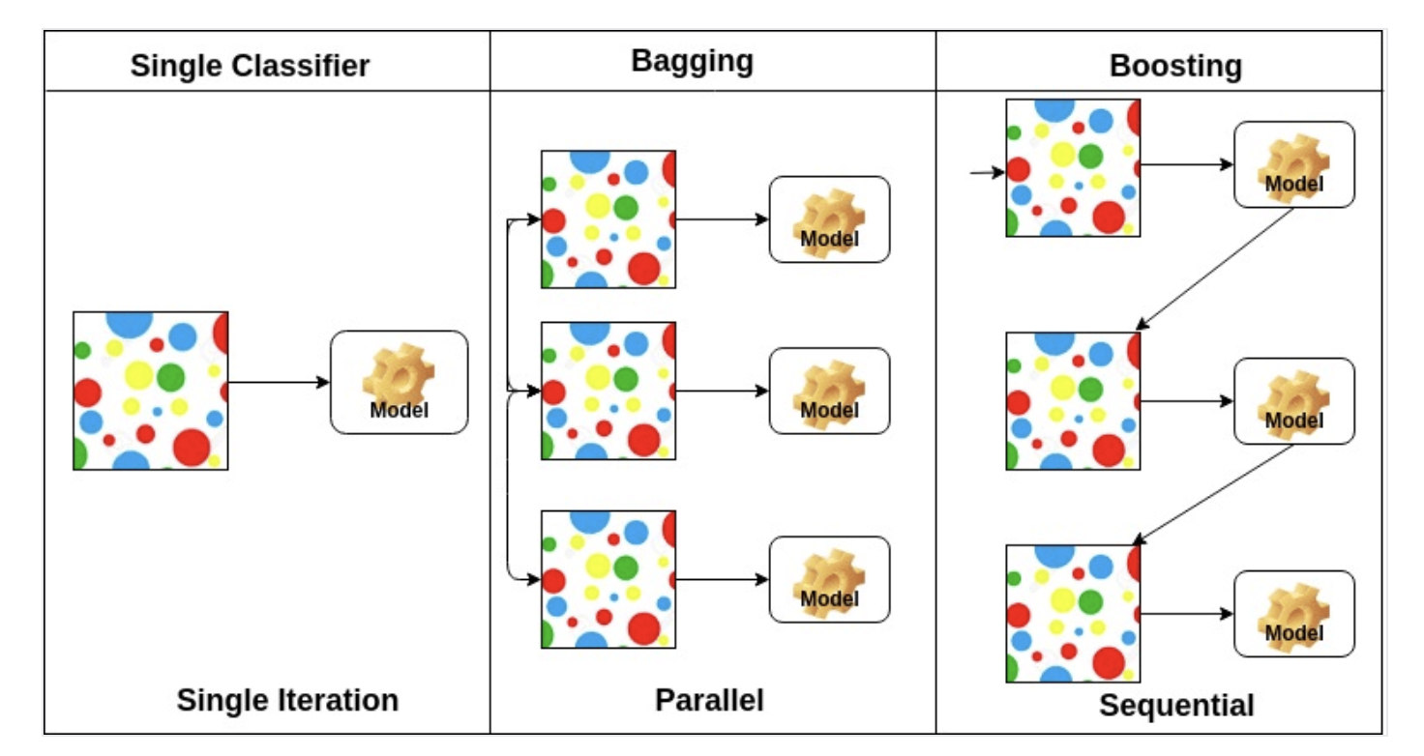
Comparison

Slide 40
Summary
Ensemble methods work better with unstable classifiers. i.e.. Base classifiers that are sensitive to minor perturbations in the training set.
Examples of unstable classifiers include decision trees, rule-based classifiers, and artificial neural networks.

Slide 41
References
“Introduction to Data Science" by Pang-Ning Tan, Michael Steinbach and Vipin Kumar

